Slide 1


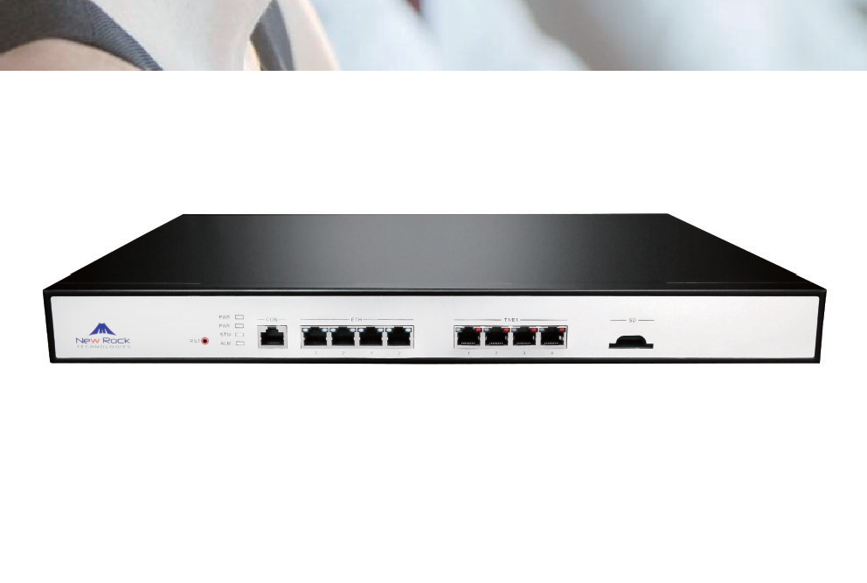
OM1000-TE SIP-ISDN Trunking Gateway
The OM1000-TE SIP-ISDN trunking gateway (OM1000-TE) provides signaling and media conversion between VoIP and ISDN networks.
A typical application is to support enterprise PBX upgrades to IP when the WAN access is ISDN.
The OM1000-TE supports 1/2/4 T1/E1 ports and up to 512 SIP trunks, to meet the requirement of large and medium-sized enterprises for VoIP services.
High Performance
OM1000-TE uses a special-purpose high-performance speech processing DSP chip.The DSP daughter card’s 6000 MIPS processing capability enables the OM1000-TE to provide voice signal processing (G.711, G.729A, and G.723.1), echo cancellation, and T.38 fax relay under full load conditions (120 calls).
High Security
To ensure security, the OM1000-TE supports SSH and HTTPS for remote access, and provides functions including signaling and media stream encryption, automatic password strength test, brute-force password cracking prevention, cipher text data storage, access whitelist, and system log backup.
OM1000-TE
T1/E1 ports: 1/2/4 Max. concurrent calls: 120
BHCC: 40K
High Reliability
The OM1000-TE provides high availability features including 1+1 redundancy of Ethernet ports and AC/DC power supplies (optional), and SIP registration failover.
Features
Supports SIP and IMS protocols
Up to 500 routing and call number transformation rules
Dual-redundant ethernet ports
Dual AC/DC power supplies (optional)
1000 SIP Trunks
TLS/SRTP
Voice VLAN
Remote access via New Rock Cloud
Management with New Rock or third-party Equipment Management System (TR-069)
Interoperability with popular SIP servers, such as Cisco Unified CallManager (CUCM), Broadsoft, Microsoft Skype for Business (Lync), Huawei IMS, and Asterisk/Elastix
Remote Management and Maintainability
The New Rock Cloud client inside the OM1000-TE allows the OM1000-TE located behind an enterprise NAT or firewall to be accessed across Internet securely. Real-time monitoring, alarm notification, remote packet capture and software upgrades can be performed with the New Rock or third-party Equipment Management System with TR-069.
Comprehensive Feature Set
As an intelligent gateway running on an embedded Linux operating system, the OM1000-TE supports an advanced feature set such as number transformation for calling/called party, automatic routing, RADIUS billing interface, 2nd-stage dialing tone and ring-back tone, auto dialing, DTMF detection, call-progress analysis, and RTP proxy for NAT/firewall traversal.
www.newrocktech.com

Slide 2
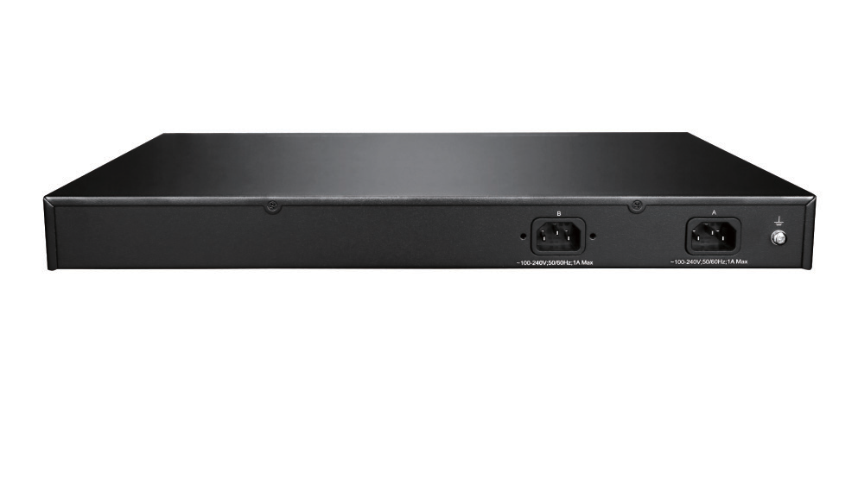








OM1000-TE SIP-ISDN Trunking Gateway
Specifications
Status and statistics Call status and history, Device status monitoring
and ISND status monitoring
ISDN maintenance BERT, Near and loop back, ISDN-D & ISDN-B
channel
Upgrade Firmware upgrade via Web GUI or Auto provisioning
Protocols
Call control Network
SIP/UDP and SIP/TCP (RFC3261), IMS (3GPP)
Telnet, SSH, HTTP, HTTPS, DHCP/PPPoE client, DNS (A/SRV record), STUN
Media Processing
Codecs G.711 (a/μ), G.729a, G.723.1, GSM, iLBC
Fax over IP T.38, G.711 pass-through
T.38 compliant Group 3 Fax Relay
Maximum fax rate of 33,600 bps (pass-through)
Voice-quality e Echo cancellation (G.168-2004), Jitter buffer,
nhancement
Silence suppression (VAD, CNG), PLC
Voice processing RTP proxy, Firewall traversal, NAT traversal
Auth.&Registration Up to 512 SIP trunks registration
Others Number transformation, 500 routing rules,
Digit map, RADIUS
Add-on Software
Finder
Obtains IP addresses of devices in a LAN environment
Product Certification
Telecom Equipment The certificate is issued by the Ministry of
Access to Network
License
Industry and Information Technology of the People's Republic of China NO:04-A555-203121
Hardware
QoS
Ethernet port | RJ-45, 4×10/100/1000 Base-T, self-adaptive
T1/E1 ports | 1, 2, or 4 ISDN trunks, supporting up to 120 simultaneous VoIP calls
SD card interface | 1
CON interface | 1, RJ45
RAM | 512 MB
Flash | 64 MB
Size (H×W×D) | 44×440×300 mm (1U)
Net weight | 3kg maximum
Single/Dual AC power supplies | 100 - 240 VAC, 50/60 Hz, 1A maximum
Single/Dual DC power supplies | -36 to -72 VDC, 2.5A
Power consumption | 18 W
Mounting | Rack
Operating | Temperature: 0 to 40°C, Humidity: 10% to 90% RH (non-condensing)
Storage | Temperature: -40 to 70°C, Humidity: 5% to 90% RH (non-condensing)
QoS DiffServ, TOS, 802.1P/Q VLAN tagging
Signaling
PSTN access E1 ISDN PRI (30 B+D): ETSI EDSS1
T1 ISDN PRI (23 B+D): ANSI NI-2
Switch type: 5ESS Series, DMS Series
Security
DTMF In-band audio, RFC2833, SIP-INFO
Protocol HTTPS, SSH, TLS, SRTP
User-defined ports SIP port, RTP port, HTTP/HTTPS port
Encryption Encryption on SIP signaling or/and media streams.
Importing and exporting encrypted configuration file and password/PIN
Intrusion Access whitelist, Blocking ping response,
prevention
SIP-allowed IP addresses
High Availability
Redundancy Dual Ethernet ports, Dual AC/DC power supplies (optional)
PSTN failover SIP registration failover from primary server to standby server
Provisioning, Administration and Maintenance
Humidity: 5% to 90% RH (non-condensing)
Device New Rock UMS, TR-069 management (TR-069,
management
TR-104 and TR-106)
Remote access New Rock Cloud
over TCP
Auto provisioning Download configuration file via TFTP/FTP/HTTP/
HTTPS, Obtaining ACS address via DHCP option 66 or redirection
Log management 8-level logs, Syslog
Data capture Port capture, Packet capture
New Rock Technologies, Inc. is a leading provider of Voice over IP products in China, offering wide range of VoIP products including all-in-one IP-PBX, hybrid IP-PBX, media gateway, session boarder controller, and related application software. We work with service providers, system integrators, distributors, resellers, independent software vendors, as well as OEM partners.

